Slide 1
Photosynthesis foldable Notes:

Slide 2
Flap Labels:
Photosynthesis:
Purpose and Location
Energy Conversion
Equation
Chloroplast Diagram
Comparison

Slide 3
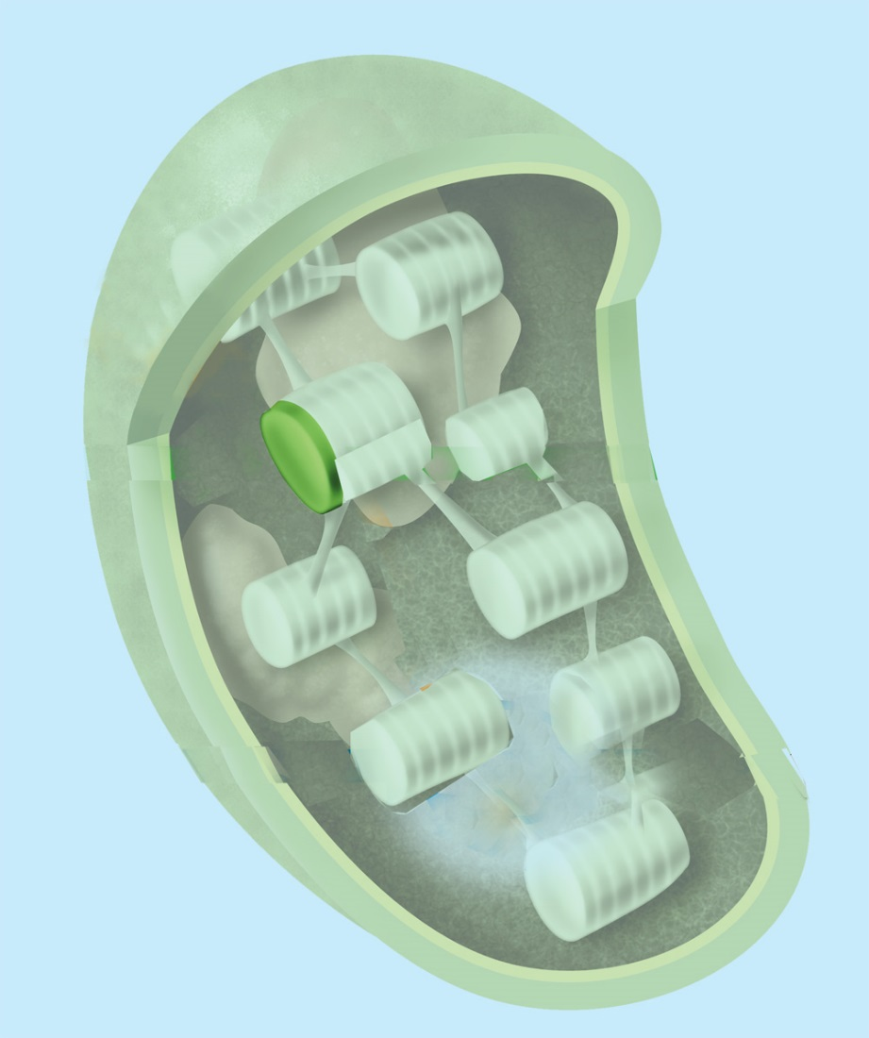
Purpose and Location……. (Write in foldable, draw and label picture)
thylakoids
Photosynthesis takes place in two parts:
Thylakoids
Stroma
Chlorophyll is a pigment found in the chloroplasts.
Chlorophyll absorbs sunlight.
chloroplast
stroma

Slide 4
Energy Conversion (What you need to write)
The purpose of Photosynthesis is to use radiant energy (sunlight) to convert water and carbon dioxide into oxygen and high energy carbohydrates (sugars/glucose)

Slide 5
Photosynthesis Equation…. (write in foldable)
6CO₂ + 6H₂0 C₆H₁₂O₆ + 6O₂
Carbon Dioxide + Water Glucose + Oxygen
Reactants (In) Products (Out)
Sunlight
Sunlight

Slide 6
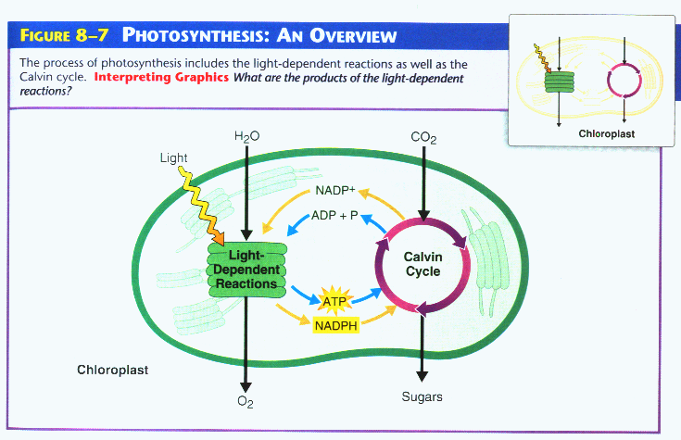
Photosynthesis Diagram (draw/Label on top flap)

Slide 7
Photosynthesis Diagram (Write on lower flap)
Photosynthesis occurs in two reactions
Light- dependent reaction
Calvin Cycle (Light independent)
The light-dependent reaction occurs in the Thylakoids.
water and sunlight are brought in (Reactants)
Oxygen molecules are released (product)
Calvin Cycle (light-independent) occurs in the stroma
Carbon dioxide is brought in (Reactants)
Glucose Molecules (C₆H₁₂O₆ ) are released (Products)

