Slide 1
Genetics 101

Slide 2
Click Below to play video
https://www.youtube.com/watch?v=VJycRYBNtwY

Slide 3
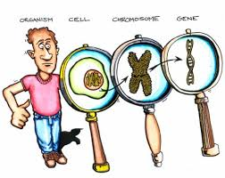
chromosome
A threadlike structure of nucleic acids (DNA) and proteins (histones) found in the nucleus of most living cells.
Carrying genetic information in the form of genes.

Slide 4
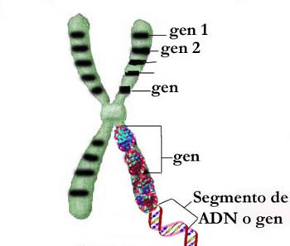
Genes
Genes are segments of DNA found on chromosome that carry information for protein production. (#protein synthesis)
Genes are responsible for the inheritance of specific traits.
You inherit genes from your biological parents.

Slide 5
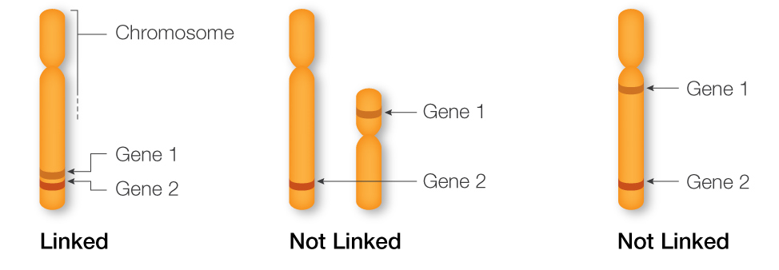
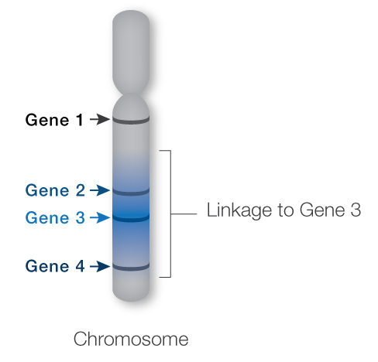
Linked Genes
Linked genes sit close together on a chromosome, making them likely to be inherited together.
Gene 3 is more closely linked to Gene 2 than to Gene 4. Gene 1 and Gene 3 are not linked, but by chance they will still be inherited together 50% of the time.
But not all genes on a chromosome are linked. Genes that are farther away from each other are more likely to be separated during a process called crossing over in meiosis.
Genes on different chromosomes are never linked

Slide 6
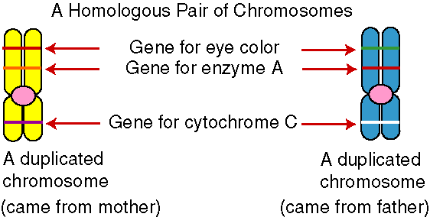
Homologous Chromosomes
Homologous chromosomes have the same genes arranged in the same order at the same location (locus) for each chromosome, but they have slightly different DNA sequences.
Different versions of the same gene are called alleles (uh-LEELZ)
Homologous chromosomes often contain different alleles because one comes from the mother and the other comes from the father.

Slide 8
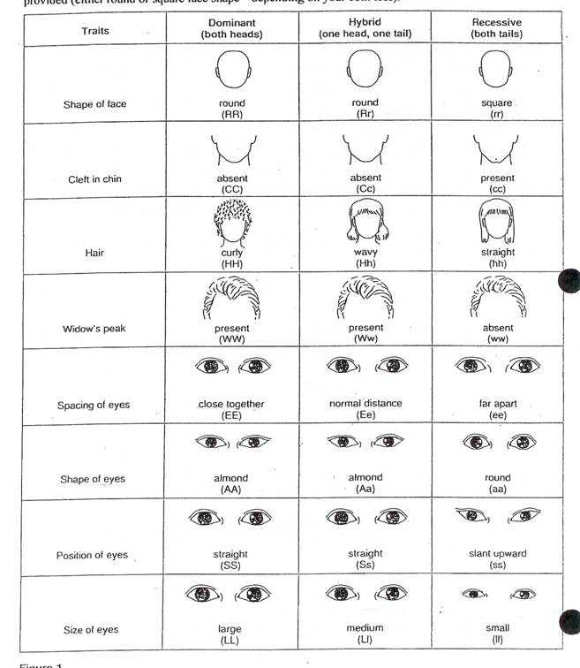
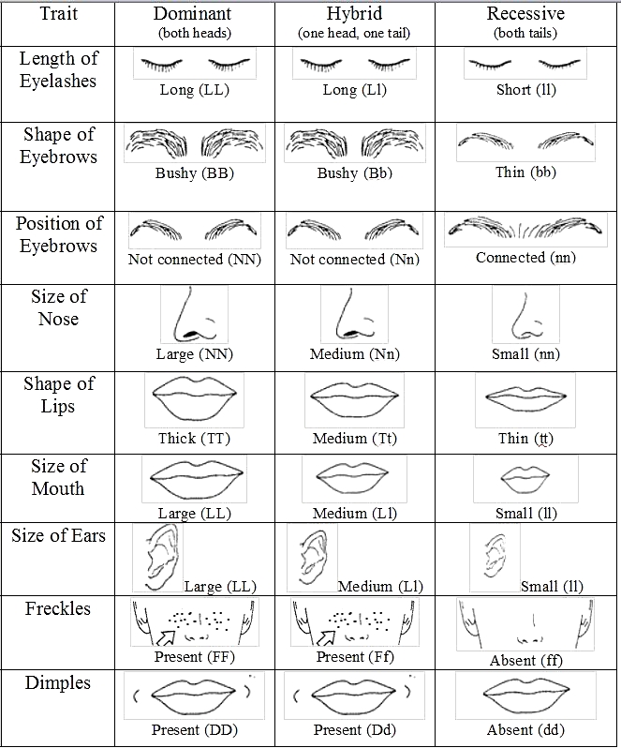
alleles
Different versions of the same gene are called alleles (uh-LEELZ)
Alleles are important because they account for the differences in inherited characteristics from one individual to another.
Homologous chromosomes often contain different alleles because one comes from the mother and the other comes from the father.
For example, different alleles for eye color can make our eyes blue, green, or brown.

Slide 9
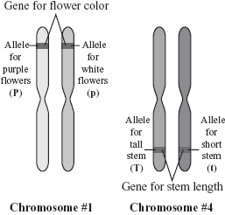
Alleles
An allele is a variant form of a gene.
Some genes have a variety of different forms, which are located at the same position, or genetic locus, on a chromosome.
Diploid organisms have two alleles at each genetic locus, with one allele inherited from each parent.

Slide 10
Click Below to play video
https://www.youtube.com/watch?v=lal1aaf14PQ

Slide 11
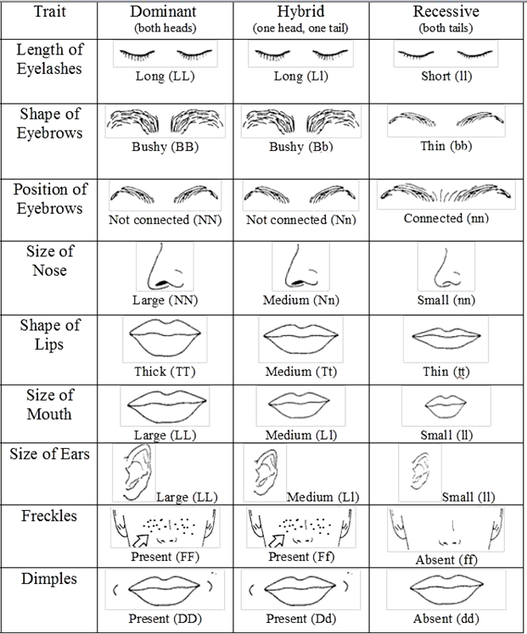
Genotype
The set of genes in our DNA which is responsible for a particular trait.
In other words:
It is a combination of alleles located on homologous chromosomes that determines a specific characteristic or trait.
This is the genetic makeup of an organism.
Genotypes are represented with upper and lower case letters

Slide 12
Genotype
A particular genotype is described as homozygous if it features two identical alleles: Homozygous Dominant
Homozygous Recessive
Heterozygous if the two alleles differ.

Slide 13
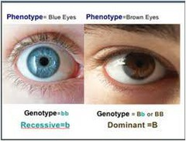
Phenotype
The phenotype is the physical expression, or characteristics, of that trait.
In other words:
How the gene(s) are expressed.
Genes carry instructions, and the result of our body following those instructions (for example, making a pigment in our eyes).
Sometimes a trait is the result of many different genes, like the 16 genes responsible for eye color

Slide 14
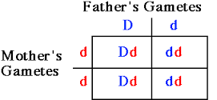
Punnett square
The Punnett square is a diagram that is used to predict an outcome of a particular cross or breeding experiment.
The diagram is used by biologists to determine the probability of an offspring having a particular genotype.
D = dimples
d = no dimples

Slide 15
http://science.halleyhosting.com/sci/soph/genetics/notes/sexlinked.htm
http://learn.genetics.utah.edu/content/pigeons/geneticlinkage/
http://www.nature.com/scitable/definition/allele-48

