Slide 1
Cellular Respiration Foldable Notes:

Slide 2
Flap Labels:
Cellular Respiration:
Purpose and Location
Energy Conversion
Equation
Mitochondria Diagram
Comparison

Slide 3
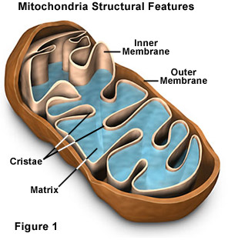
Purpose and Location……. (Write in foldable, draw and label picture)
Cellular Respiration occurs in two organelles:
Cytoplasm
mitochondria.
Cellular Respiration has three steps:
Glycolysis (cytoplasm)
Krebs Cycle (mitochondria)
Electron Transport Chain (mitochondria)

Slide 4
Energy Conversion (What you need to write)
The purpose of Cellular Respiration is to convert Glucose (sugar) in the presence of Oxygen into stored energy in the bonds of ATP.

Slide 5
Cellular Respiration (write in foldable)
C₆H₁₂O₆ + 6O₂ 6CO₂ + 6H₂0 + 36ATP
Glucose + Oxygen Carbon Dioxide + Water + ATP
Reactants (In) Products (Out)

Slide 6
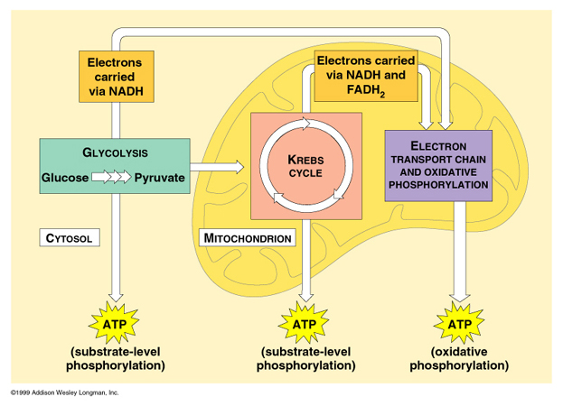
Mitochondria Diagram (draw/Label on top flap)
0₂
Cytoplasm
Mitochondria
H₂O
CO₂
2
2
32

Slide 7
Mitochondria Diagram- Three Steps (Write on lower flap)
2. Krebs Cycle: Mitochondria
Pyruvic acid is taken in from Glycolysis
Carbon Dioxide is released (whole reason why we exhale)
This makes 2 Molecules of ATP
3. Electron Transport Chain: Mitochondria
Converts ADP to ATP
This makes Water and 32 Molecules of ATP
1. Glycolysis: Cytoplasm
Glucose (C₆H₁₂O₆) is broken down into 2 smaller molecules (pyruvic acid)
Pyruvic Acid is now enters the mitochondria
This makes 2 molecules of ATP

Slide 8
Comparison
 | Photosynthesis: | Cellular Respiration:
Reactants: | Sunlight, Carbon Dioxide and Water | Glucose, and Oxygen
Products: | Glucose and Oxygen | Carbon Dioxide, water and ATP
Organelle: | Chloroplast | Mitochondria
Uses _______ to make ATP | Light Energy | Glucose
Equation: | 6CO₂ + 6H₂0 + sunlight C₆H₁₂O₆ + 6O₂ | C₆H₁₂O₆ + 6O₂ 6CO₂ + 6H₂0 + ATP

