Slide 1
Cell Cycle
I P M A T C

Slide 2
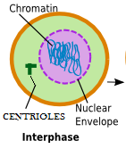
INTERPHASE
CHROMOSOMES UNCOIL AND IS CALLED CHROMATIN
G1-PHASE: CELL GROWTH OCCURS
S-PHASE: DNA RELIPCATION OCCURS
G2-PHASES: CELL CHECK POINT OCCURS AND ADDITIONAL GROWTH
Chromatin
Nuclear
Envelope
Centrioles

Slide 3
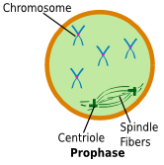
PROPHASE
CHROMOSOMES CONDENSE (COIL UP AROUND HISTONES)
NUCLEAR ENVELOPE BREAKS DOWN
SPINDLE FIBERS BEGIN TO FORM
CENTRIOLES MOVE TO OPPOSITE POLES
Chromosome
Spindle
Fibers
Centriole

Slide 4
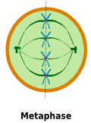
METAPHASE
CHROMOSOMES ALIGN AT THE EQUATOR (MIDDLE)
CENTRIOLES AT OPPOSITE POLES
SPINDLE FIBERS ATTACH TO CHROMOSOMES
Equator

Slide 5
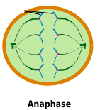
ANAPHASE
Sister Chromatids
SPINDLE FIBERS PULL SISTER CHROMATIDS APART
PLASMA MEMBRANE ELONGATES (looks like an oval)
CYTOKINESIS BEGINS HERE

Slide 6
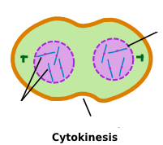
TELOPHASE
CELL BEGINS TO CLEAVE AND FORM TWO IDENTICAL DAUGHTER CELLS
NUCLEAR ENVELOPE BEGINS TO FORM
CHROMOSOMES START TO UNCOIL (CHROMATIN)
SPINDLE FIBERS ARE DISSOLVING
Nuclear
Envelope
Chromosomes
Cleavage Furrow

Slide 7
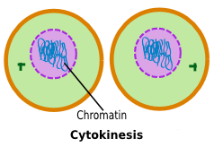
CYTOKINESIS
CYTOKINESIS BEGINS IN ANAPHASE
DIVISION OF THE CYTOPLASM & ORGANELLES
RESULTS IN 2 IDENTICAL DIPLOID DAUGHTER CELLS
DIPLOID – CONTAINS 2 OF EACH CHROMOSOME
Daughter Cells
Chromatin

Slide 8
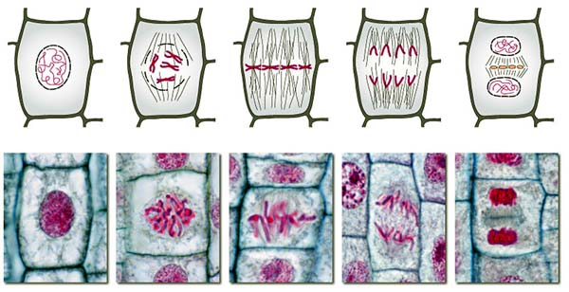
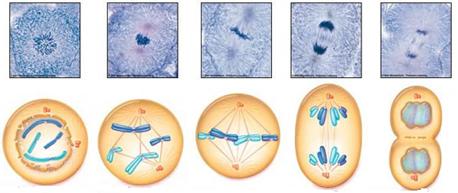
CELL CYCLE: PLANT CELL vs ANIMAL CELL

