Slide 1
Bacteria
4D identify and describe the role of bacteria in maintaining health such as in digestion and causing diseases such as in streptococcus infections and diphtheria.

Slide 2
Bacteria—What Are They?

Slide 3
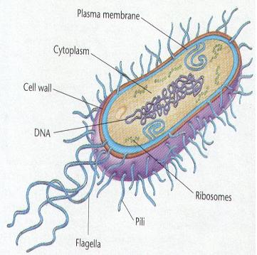
Bacteria—What Are They?
Bacteria is plural for Bacterium.
A bacterium is a microbe (a microscopic single cell organism) that can be found virtually anywhere. They are in air, soil, water, and in and on plants and animals.

Slide 4
Bacteria—What Are They?
Are Prokaryotic cells
Single celled organisms
No organized nucleus (duh!)
Few cell parts
Contain a single circular chromosome

Slide 5
Types of Bacteria
Eubacteria – live almost everywhere, fresh water, salt water, land, within the human body
Archaebacteria – live in extremely harsh environments, like thick mud, extremely salty environments, hot springs

Slide 6
How Do They Look?

Slide 7
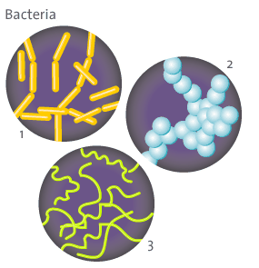
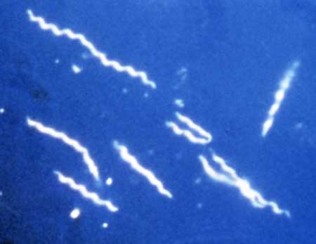
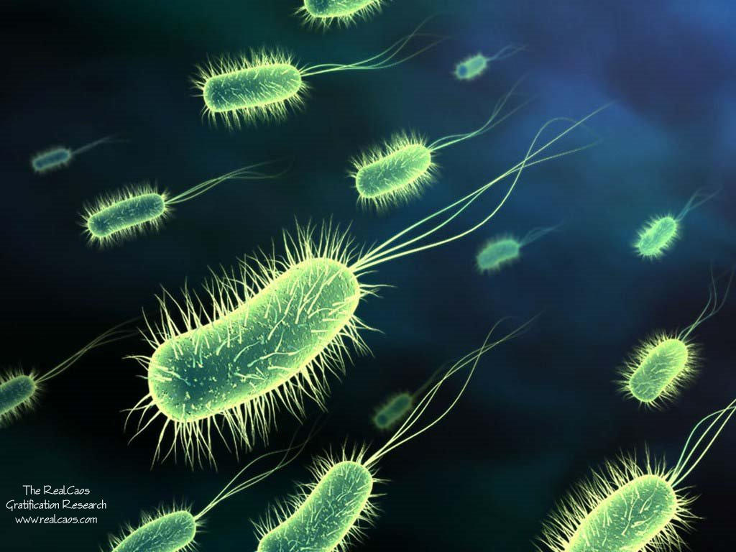
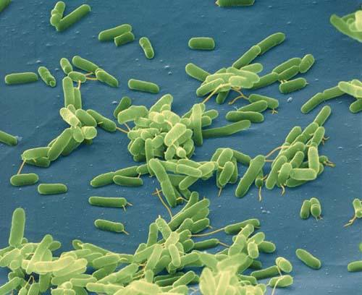
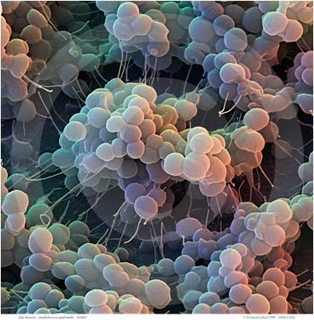
Appearance
Bacteria cells have various shapes
The three basic shapes are:
Bacillus – Rod Shaped
Spirilus – Spiral
Coccus – Round/Curved

Slide 8
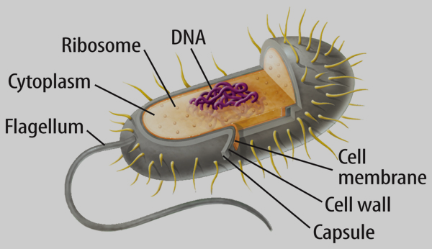
Pili

Slide 9
How Viruses and Microbes Impact Humans
(Interactive Notebook Pg. 22)

Slide 10
Viruses
(left side)

Slide 11
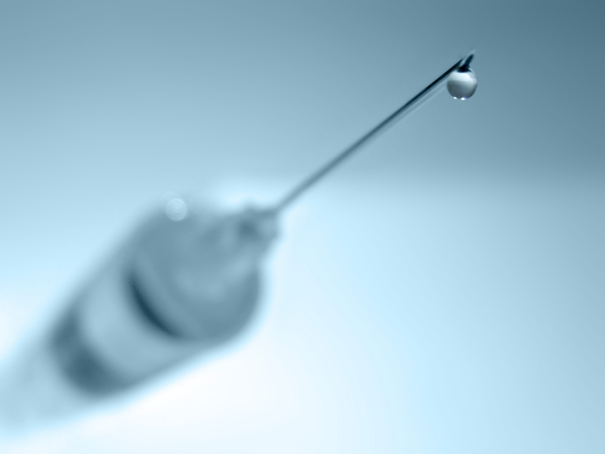
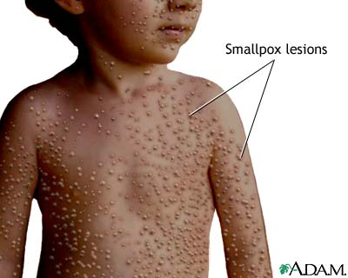
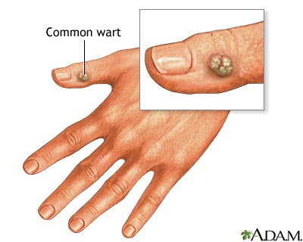
Harmful:
Something that causes disease is called pathogenic
A disease producing agent is called a pathogen
Human Diseases: Warts, common cold, Influenza (flu), Smallpox, Ebola, Herpes, AIDS, Chicken pox, Rabies
Viruses can be prevented with vaccines, but NOT treated with antibiotics.
(antibiotics treat bacteria)
Beneficial:
Genetic Engineering—harmless virus carries genes into cells.
Phage Therapy – using viruses to kill pathogenic bacteria

Slide 12
The Body’s Response to Viruses (Antibodies)
In the US, viruses are responsible for approx. 80% of all infectious disease.
Mammals protect themselves by producing antibodies to the virus
An antibody is a protein secreted by cells in the immune system in response to a foreign substance in the body.
The antibodies attach to the virus and flag it.
If the virus was not destroyed directly by the antibody or held captive by it until the virus can be surrounded and destroyed by white blood cells

Slide 13
The Body’s Response to Viruses (Antibodies)
If this doesn’t happen, the body can be reinfected
These specific antibodies remain in the body of the organism after the virus has been destroyed.
If the same virus attempts another invasion, it is quickly killed by the antibodies.
Vaccines cause the body to produce antibodies to a virus to prevent infection
Sometimes similar viruses are used to make vaccines for other viruses.

Slide 14
Bacteria
(right side)

Slide 15
Benefits of Bacteria
Bacteria are vital to maintaining the living world because:
Some are producers and can put oxygen back into the atmosphere
They are decomposers and can break down dead organic matter
Nitrogen fixation – bacteria live in symbiotic relationship with legumes (bean plants) to convert nitrogen gas to a usable form of nitrogen for plants.

Slide 16
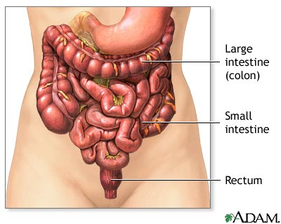
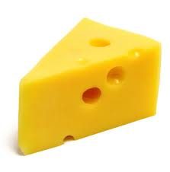
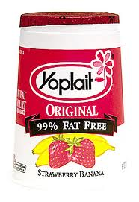
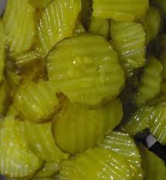
Beneficial Bacteria
4. Bacteria can also be helpful in the large intestine by preventing infections and producing substances we need, such as vitamin B and K.
5. Bacteria are also essential to the production of yogurt, cheese, and pickles.

Slide 17
Beneficial Bacteria
6. Bacteria are used to synthesize drugs
Example: Genetically engineered E. coli is used to produce insulin

Slide 18
Harmful effects of Bacteria
Bacteria can invade our cells and use them as food.
Bacteria can produce toxins that are poisonous waste products which damage our cells.
Some bacteria become antibiotic-resistant due to overuse of antibiotics.
Example: MRSA Methicillin-resistant Staphylococcus aureus

Slide 19
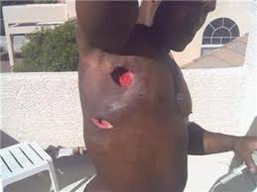
Common Bacterial Diseases
Strep-throat
Tooth Decay
Chlamydia
Lyme Disease
Tuberculosis
Cellulitis
Methicillin-resistant Staphylococcus aureus (MRSA) is a bacterium that causes infections in different parts of the body.
Most often, it causes mild infections on the skin, causing sores or boils

Slide 20
Treating and Controlling Bacteria
Sterilization – heat, boiling water, hand washing
Disinfectants – Example – Lysol
Food storage and processing – canning, keeping food cold or frozen
Vaccines – many bacteria have vaccines to prevent them
Once a harmful bacteria has infected the body, antibiotics can be used to attack and destroy the bacteria

Slide 21
Questions

Slide 22
1. Some antibiotics cause patients to exhibit digestive side effects. These side effects are most often the result of —
bacteria being killed in the digestive tract
the antibiotics being converted into stomach acids
too much water being drawn into the digestive tract
the stomach wall being torn

Slide 23
2. Bacteria are present in the digestive tract of some herbivores. The bacteria break down plant cellulose, making it possible for the herbivore to digest plant material. These bacteria live in a stable environment with sufficient food and water. The herbivore and the bacteria in this relationship —
benefit each other
compete for survival
are producers
are secondary consumers

Slide 24
3. How does using killed or weakened bacteria in an immunization help the body prevent infections?
Antibodies are formed that fight those types of bacteria.
The body develops a fever that kills beneficial bacteria.
Bacterial reproductive cycles are disrupted.
Bacteria-fighting viruses are activated.

Slide 25
STOP

Slide 26
Comparing Viruses and Bacteria

Slide 27
Virus Versus Bacteria
Viruses vs Bacteria
Virus | Bacteria

Slide 28
Virus Versus Bacteria
Viruses vs Bacteria
Virus | Bacteria
Not a cell; smaller than a cell Dormant outside a cell

Slide 29
Virus Versus Bacteria
Viruses vs Bacteria
Virus | Bacteria
Not a cell; smaller than a cell Dormant outside a cell | Single Cell; oldest form of life; no nucleus

Slide 30
Virus Versus Bacteria
Viruses vs Bacteria
Virus | Bacteria
Not a cell; smaller than a cell Dormant outside a cell | Single Cell; oldest form of life; no nucleus
Requires a host cell to reproduce for them

Slide 31
Virus Versus Bacteria
Viruses vs Bacteria
Virus | Bacteria
Not a cell; smaller than a cell Dormant outside a cell | Single Cell; oldest form of life; no nucleus
Requires a host cell to reproduce for them | Reproduce through cell division

Slide 32
Virus Versus Bacteria
Viruses vs Bacteria
Virus | Bacteria
Not a cell; smaller than a cell Dormant outside a cell | Single Cell; oldest form of life; no nucleus
Requires a host cell to reproduce for them | Reproduce through cell division
Cannot take in food

Slide 33
Virus Versus Bacteria
Viruses vs Bacteria
Virus | Bacteria
Not a cell; smaller than a cell Dormant outside a cell | Single Cell; oldest form of life; no nucleus
Requires a host cell to reproduce for them | Reproduce through cell division
Cannot take in food | Large size

Slide 34
Virus Versus Bacteria
Viruses vs Bacteria
Virus | Bacteria
Not a cell; smaller than a cell Dormant outside a cell | Single Cell; oldest form of life; no nucleus
Requires a host cell to reproduce for them | Reproduce through cell division
Cannot take in food | Large size
Cannot expel waste

Slide 35
Virus Versus Bacteria
Viruses vs Bacteria
Virus | Bacteria
Not a cell; smaller than a cell Dormant outside a cell | Single Cell; oldest form of life; no nucleus
Requires a host cell to reproduce for them | Reproduce through cell division
Cannot take in food | Large size
Cannot expel waste | Found in many environments; soil, water, air, bodies of other organisms, with or without oxygen

Slide 36
Virus Versus Bacteria
Viruses vs Bacteria
Virus | Bacteria
Not a cell; smaller than a cell Dormant outside a cell | Single Cell; oldest form of life; no nucleus
Requires a host cell to reproduce for them | Reproduce through cell division
Cannot take in food | Large size
Cannot expel waste | Found in many environments; soil, water, air, bodies of other organisms, with or without oxygen
Consists of two parts: outer coat of protein and hereditary material-DNA or RNA

Slide 37
Virus Versus Bacteria
Viruses vs Bacteria
Virus | Bacteria
Not a cell; smaller than a cell Dormant outside a cell | Single Cell; oldest form of life; no nucleus
Requires a host cell to reproduce for them | Reproduce through cell division
Cannot take in food/Cannot expel waste | Large in size
Viruses are found on or in just about every material and environment on Earth. They're basically found anywhere there are cells to infect. | Found in many environments; soil, water, air, bodies of other organisms, with or without oxygen
Consists of two parts: outer coat of protein and hereditary material-DNA or RNA | Cytoplasm contains hereditary material; DNA in circular structure called plasmid

Slide 38
Virus Versus Bacteria
Viruses vs Bacteria
Virus | Bacteria
Not a cell; smaller than a cell Dormant outside a cell | Single Cell; oldest form of life; no nucleus
Requires a host cell to reproduce for them | Reproduce through cell division
Cannot take in food | Large size
Cannot expel waste | Found in many environments; soil, water, air, bodies of other organisms, with or without oxygen
Consists of two parts: outer coat of protein and hereditary material-DNA or RNA | Cytoplasm contains hereditary material; DNA in circular structure called plasmic
Diseases: HIV, AIDS, Flu, Smallpox, Warts

Slide 39
Virus Versus Bacteria
Viruses vs Bacteria
Virus | Bacteria
Not a cell; smaller than a cell Dormant outside a cell | Single Cell; oldest form of life; no nucleus
Requires a host cell to reproduce for them | Reproduce through cell division
Cannot take in food | Large size
Cannot expel waste | Found in many environments; soil, water, air, bodies of other organisms, with or without oxygen
Consists of two parts: outer coat of protein and hereditary material-DNA or RNA | Cytoplasm contains hereditary material; DNA in circular structure called plasmic
Diseases: HIV, AIDS, Flu, Smallpox, Warts | Diseases: Strepthroat, Anthrax, Diphtheria, MRSA

