Slide 1
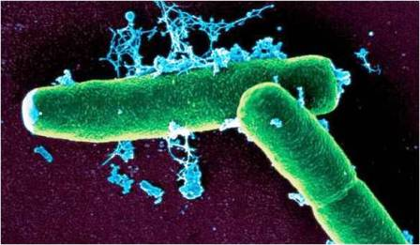
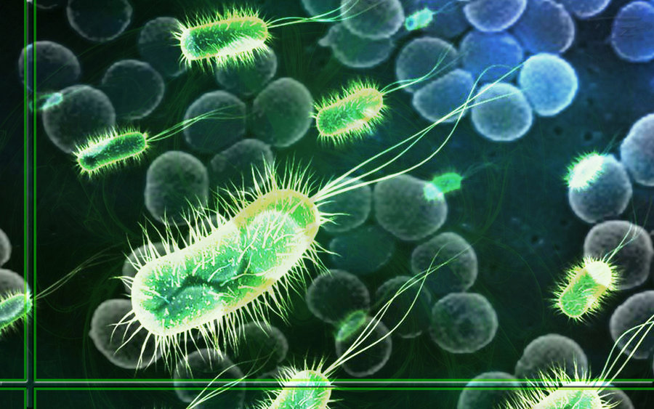
Domain
Bacteria
Eubacteria
Everyday bacteria “true bacteria” Ex – E. coli, staph., strep.
Prokaryote
Cell walls with peptidoglycan
Unicellular
Autotroph or heterotroph
Asexual
Aerobic or anaerobic
Kingdom
Description
Cell type
Cell structure
Number of cells
Nutrition
Reproduction
Metabolism

Slide 2
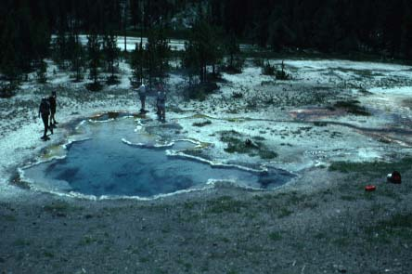
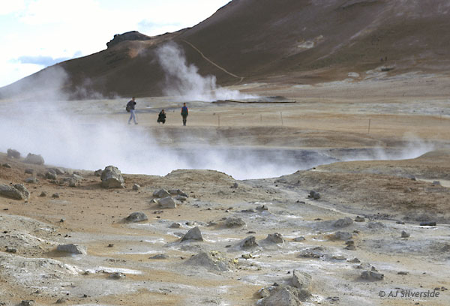
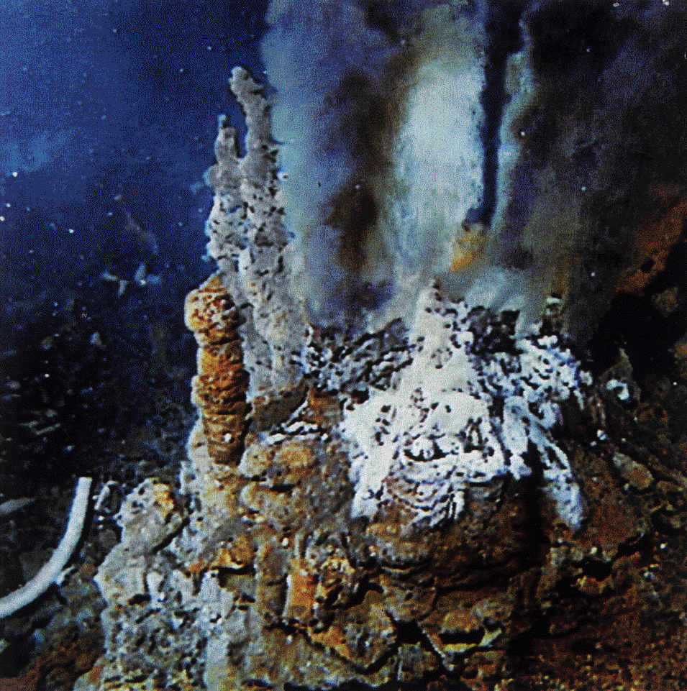
Eukarya
Domain
Archaea
Archaebacteria
Bacteria that live in extreme conditions Ex – Methanogens, Halophiles, Thermophiles
Prokaryote
Cell walls without peptidoglycan
Unicellular
Autotroph or heterotroph
Asexual
Anaerobic
Kingdom
Description
Cell type
Cell structure
Number of cells
Nutrition
Reproduction
Metabolism

Slide 3
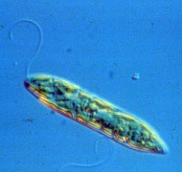
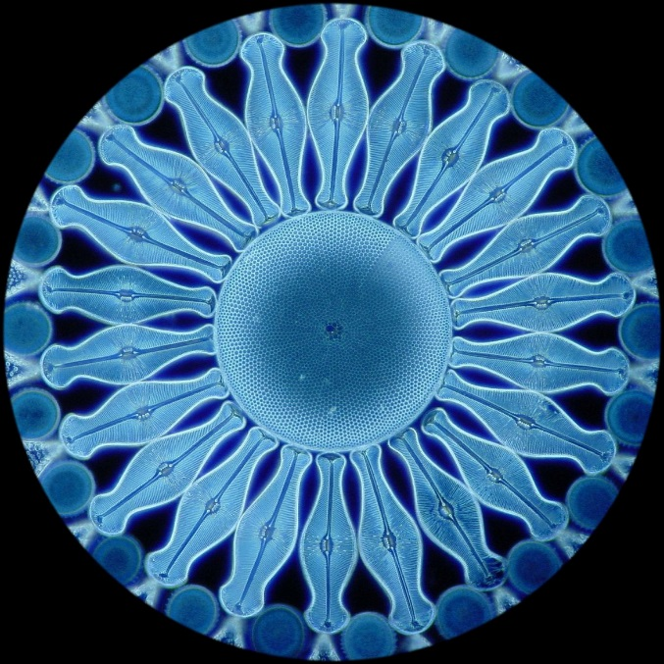
Domain
Eukarya
Kingdom
Protista
Everything else that does not fit into another kingdom Are motile
Eukaryote
Some have cell walls made of cellulose, some have cilia and/or flagella
Most are unicellular, some are colonial (live in groups), some are multicellular.
Autotroph or heterotroph
Asexual or sexual
Most are aerobic
Description
Cell type
Cell structure
Number of cells
Nutrition
Reproduction
Metabolism

Slide 4
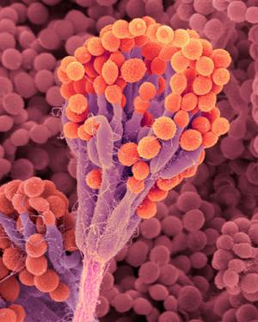
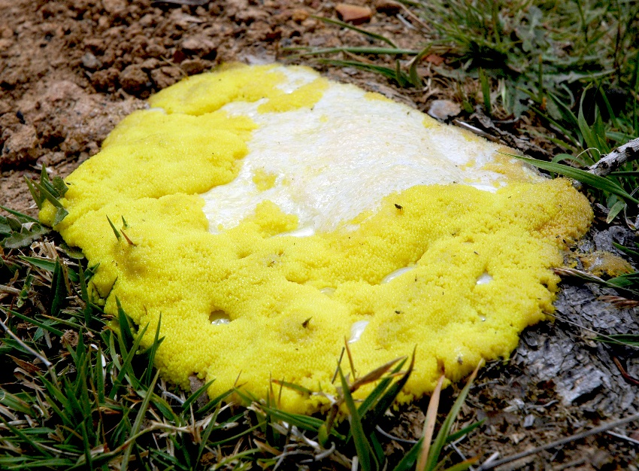
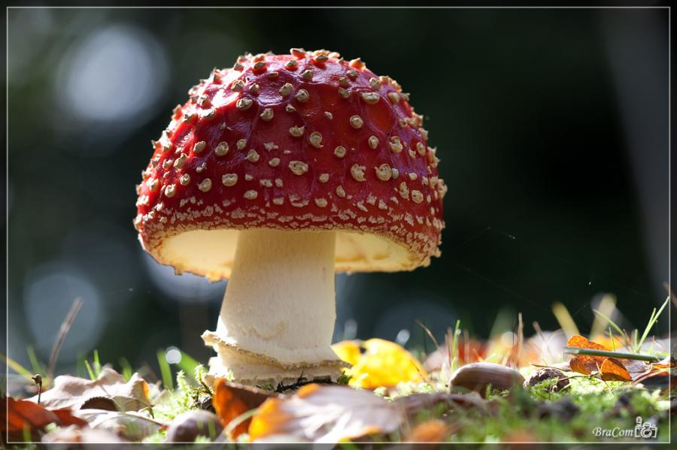
Domain
Eukarya
Kingdom
Fungi
Mushrooms and yeast
Eukaryote
Cell walls made of chitin
Most are multicellular, some are unicellular
Heterotroph
Asexual or sexual
Aerobic or anaerobic
Description
Cell type
Cell structure
Number of cells
Nutrition
Reproduction
Metabolism

Slide 5
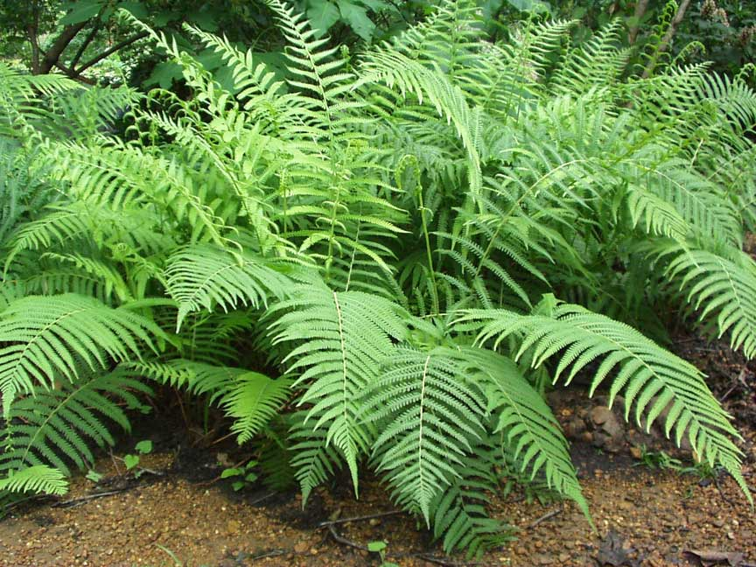
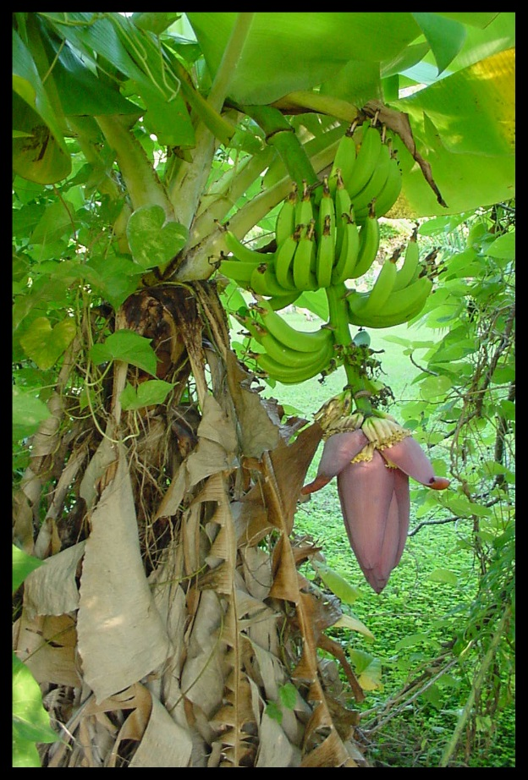
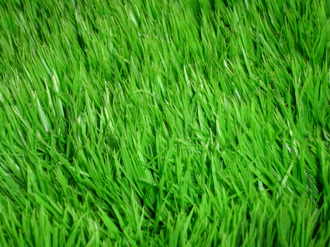
Domain
Eukarya
Kingdom
Plantae
Plants
Eukaryote
Cell walls made of cellulose, have chloroplasts
Multicellular
Autotroph
Asexual or sexual
Aerobic
Description
Cell type
Cell structure
Number of cells
Nutrition
Reproduction
Metabolism

Slide 6
Domain
Eukarya
Kingdom
Animals including humans Are motile
Eukaryote
No cell walls or chloroplasts.
Multicellular
Heterotroph
Usually sexual
Aerobic
Description
Cell type
Cell structure
Number of cells
Nutrition
Reproduction
Metabolism

Slide 7
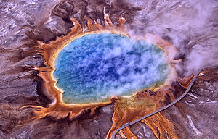
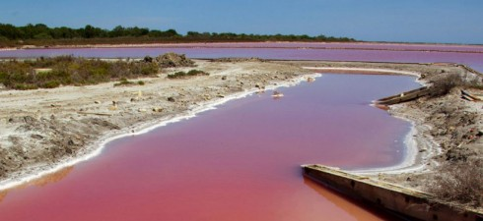
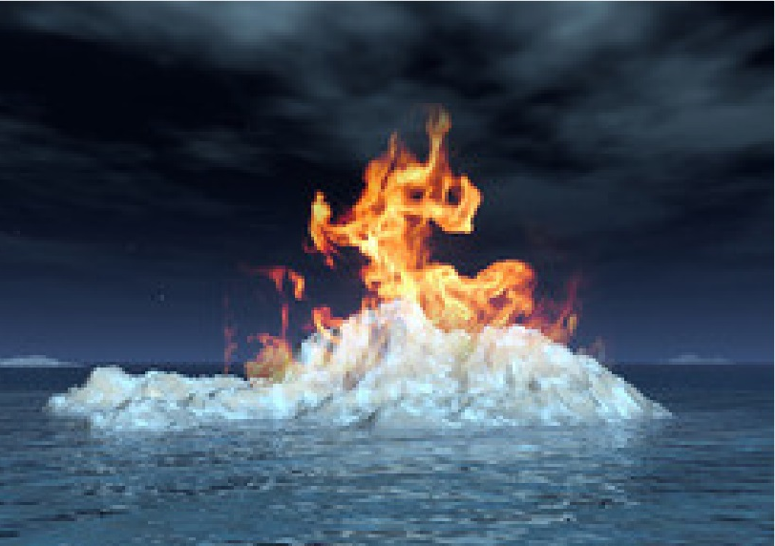
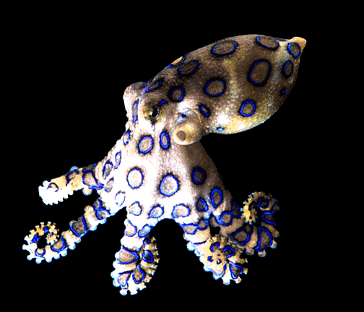
Here are some new vocabulary words that you need to know!
Methanogens – produce methane gas as a product of metabolism
Halophiles – live in extremely salty conditions
Thermophiles – live in extremely hot conditions
Motile – can move

