Slide 1
Taxonomy and classification

Slide 2
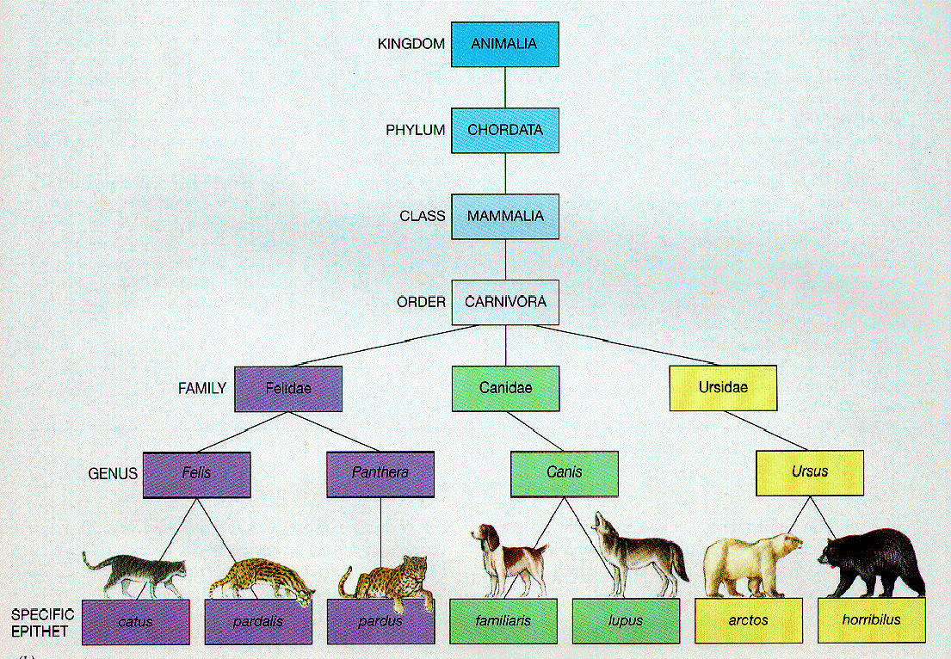
Taxonomy
Taxonomy – the scientific system of naming and classifying organisms.
Developed by Carolus Linnaeus.

Slide 3
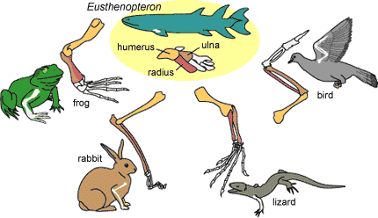
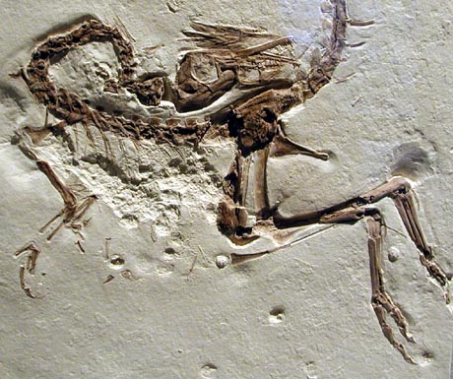
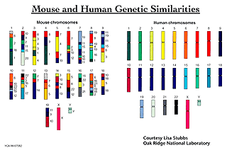
Organisms are classified into levels called taxa (one taxa is a taxon) based on:
Similarities and differences in anatomical structures
Similarities and differences in DNA sequences
Evidence from the fossil record (for extinct species)

Slide 4
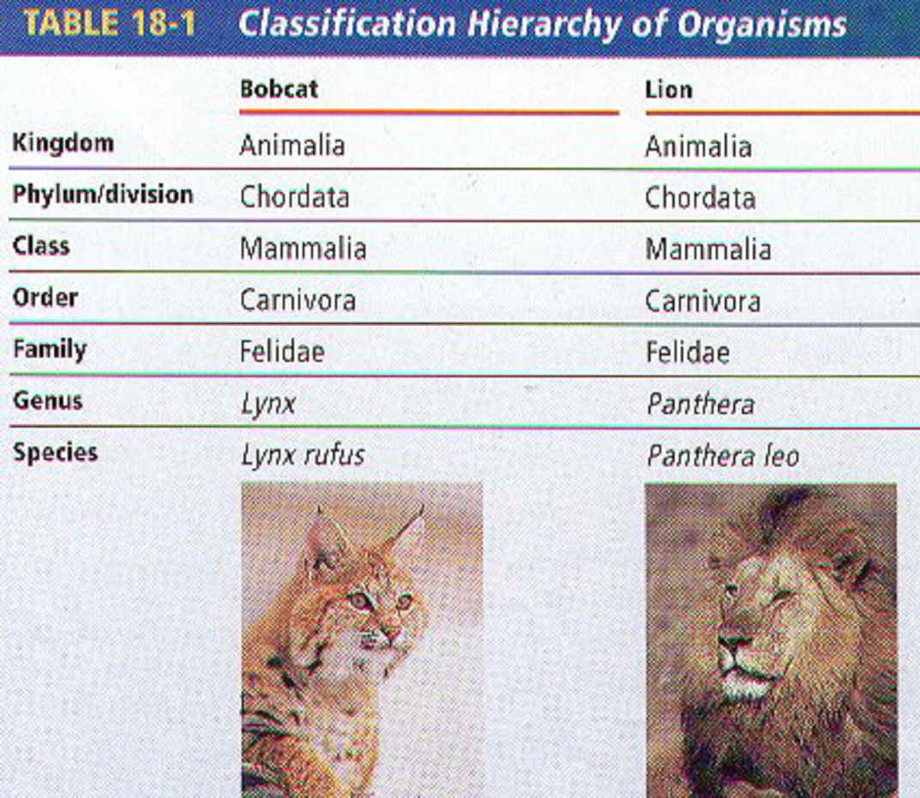
A taxon progresses from larger, more general groups to smaller, more specific groups.

Slide 5
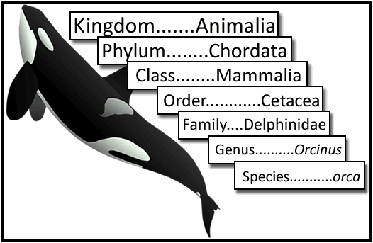
8 Main classification levels:
(Dearest King Philip Came Over For Great Soup)
Domain – Most general level
Kingdom
Phylum
Class
Order
Family
Genus
Species – most specific level
Domain…….Eukarya

Slide 6
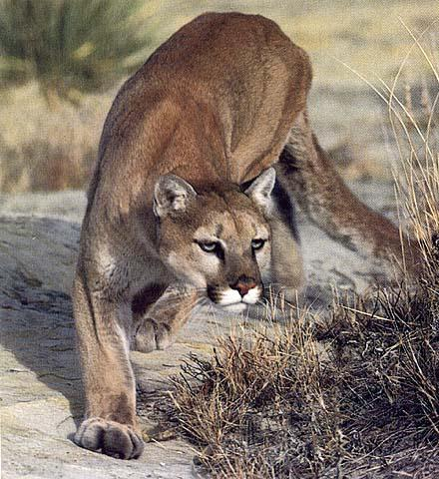
What kind of animal is this?

Slide 7
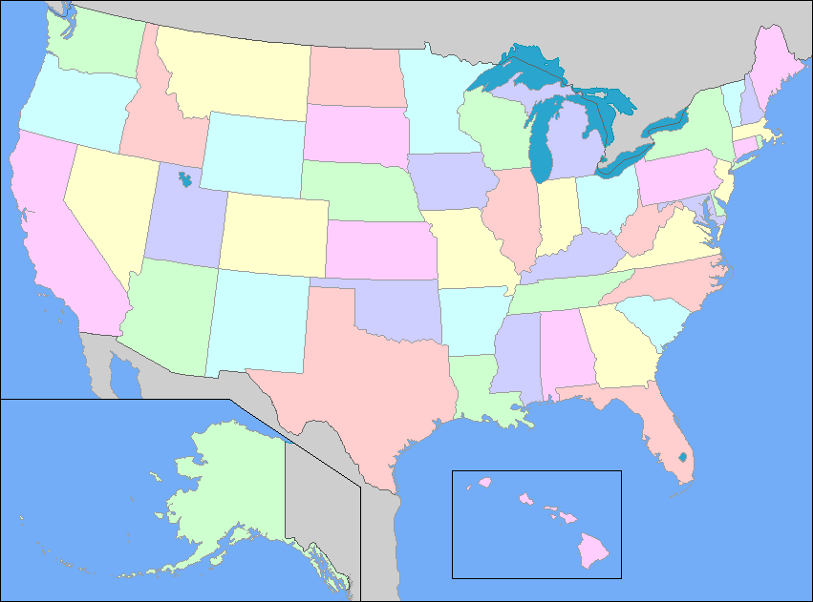
There are over 40 common names for this animal in English alone. It holds the Guiness World Record for the species with the highest number of common names.
Mountain Lion
Puma
Catamount
Cougar
Panther

Slide 8
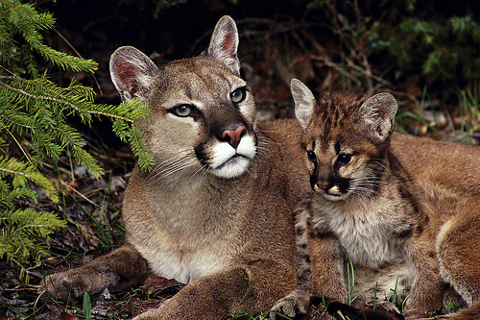
In order to make sure they are talking about the same animal, scientists use its scientific name……. Felis concolor

Slide 9
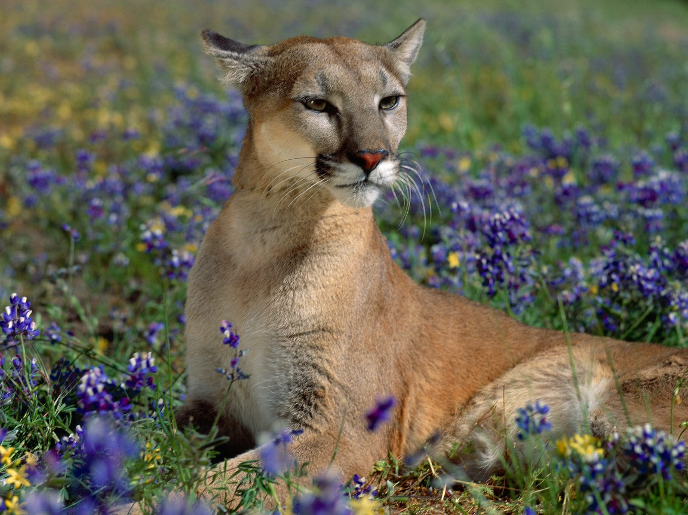
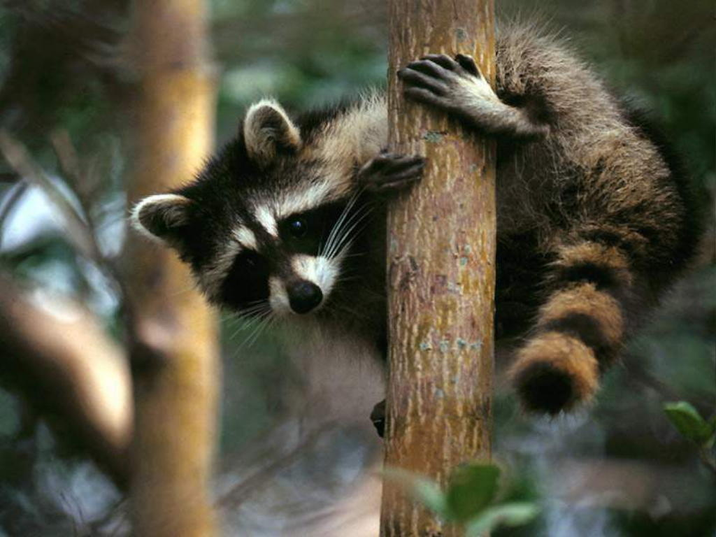
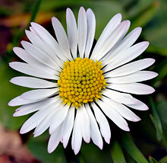
Binomial Nomenclature – 2 word scientific naming system
Used by scientists to classify organisms because they can have more than one common name.
Felis concolor
Procyon lotor
Bellis perennis

Slide 10
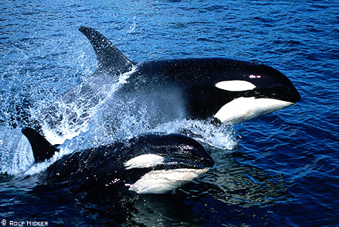
First word is the Genus (always capitalized)
Second word is the species (always with a lowercase letter)
Example – Killer whale is Orcinus orca

Slide 11
Write the scientific name for each of the following organisms:
Common Name | Scientific Name
Atlantic Cowry
Pacific Seahorse
Giant Kelp

Slide 12
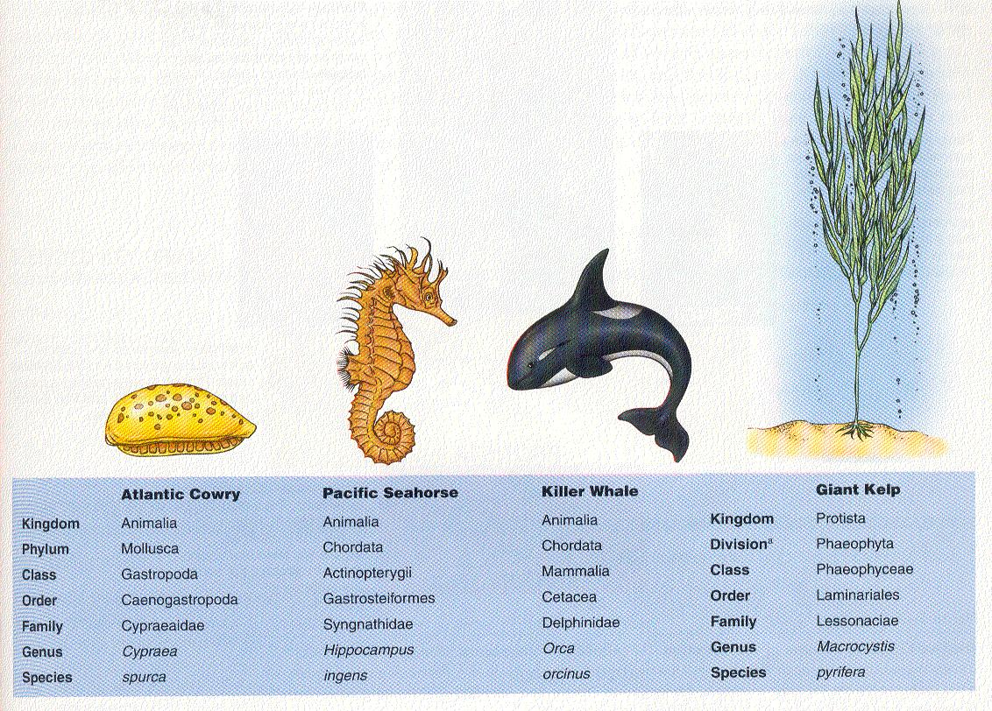
Cypraea spurca
Hippocampus ingens
Macrocystis pyrifera

