Slide 1
CELLULAR ENERGY
MAD Science Biology

Slide 2
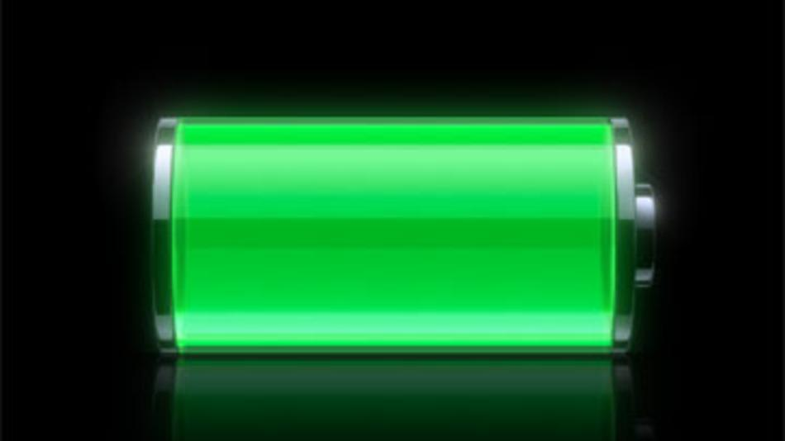
F Adenosine TRIphosphate (ATP) - a special type of nucleic acid that is the basic energy source of all cells
-ATP is like a fully charged battery that is ready to power the cell

Slide 3
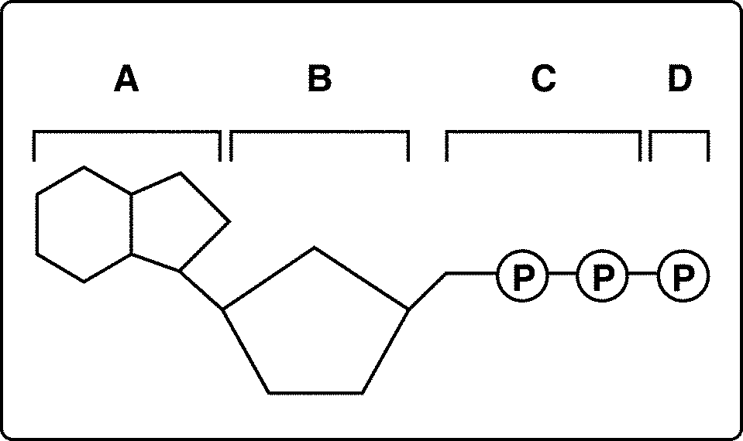
3 Phosphate Groups
Adenine
Ribose
ATP consists of:
Adenine
Ribose (a sugar)
Three Phosphate Groups
The energy in the bonds of glucose molecules transfers to the phosphate bonds in the ATP.

Slide 4
How does ATP release its stored energy?

Slide 5
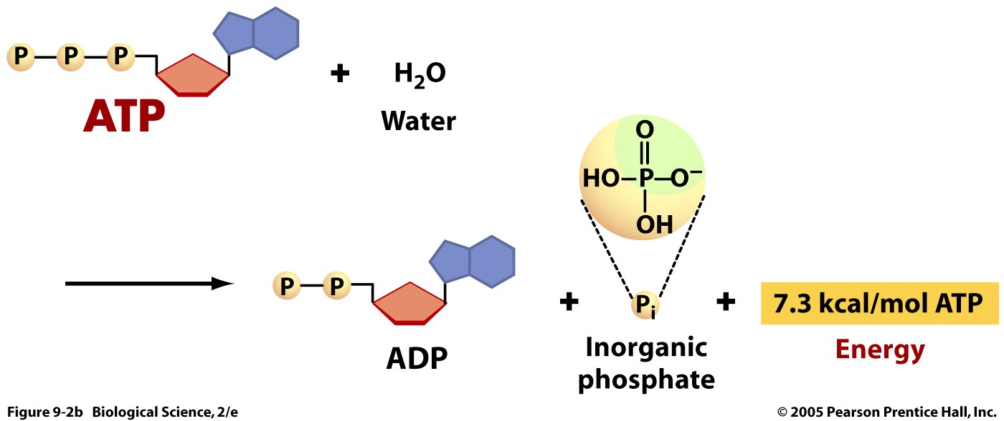

Slide 6
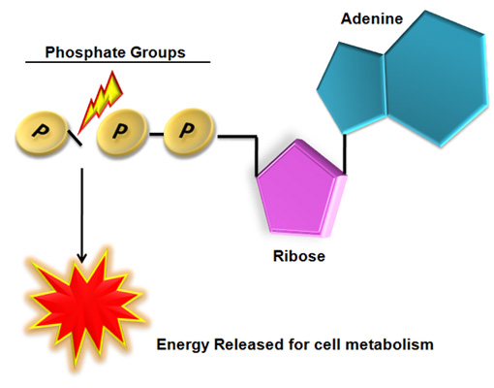
How does ATP release its stored energy?
Energy is released by breaking the bond between the 2nd and 3rd phosphate groups.
This creates Adenosine DIphosphate (ADP)

Slide 7
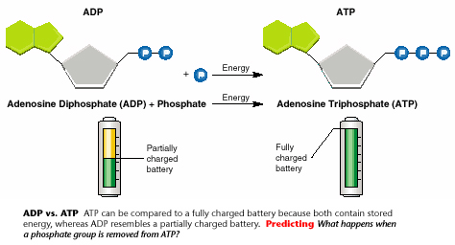
Adenosine Diphosphate is similar to a battery that has been half used

